Slide 1
LLM4TS: Two-Stage Fine-Tuning for Time-Series Forecasting with Pretrained LLM
Student: Ching (Jason) Chang
Advisors: Wen-Chih Peng, Tien-Fu Chen

Slide 2
Outline
Introduction
Related Work
Solution
Experiments
Conclusion
Future Work
3 Tasks

Slide 3
Introduction

Slide 4
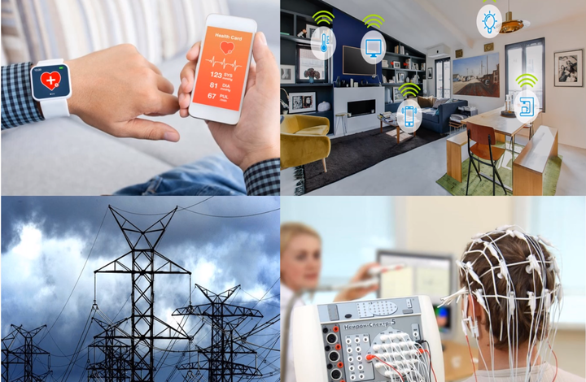
The Ubiquity of Time-Series
https://cruiseresearchgroup.github.io/project/time-series_forecasting_and_segmentation/

Slide 5
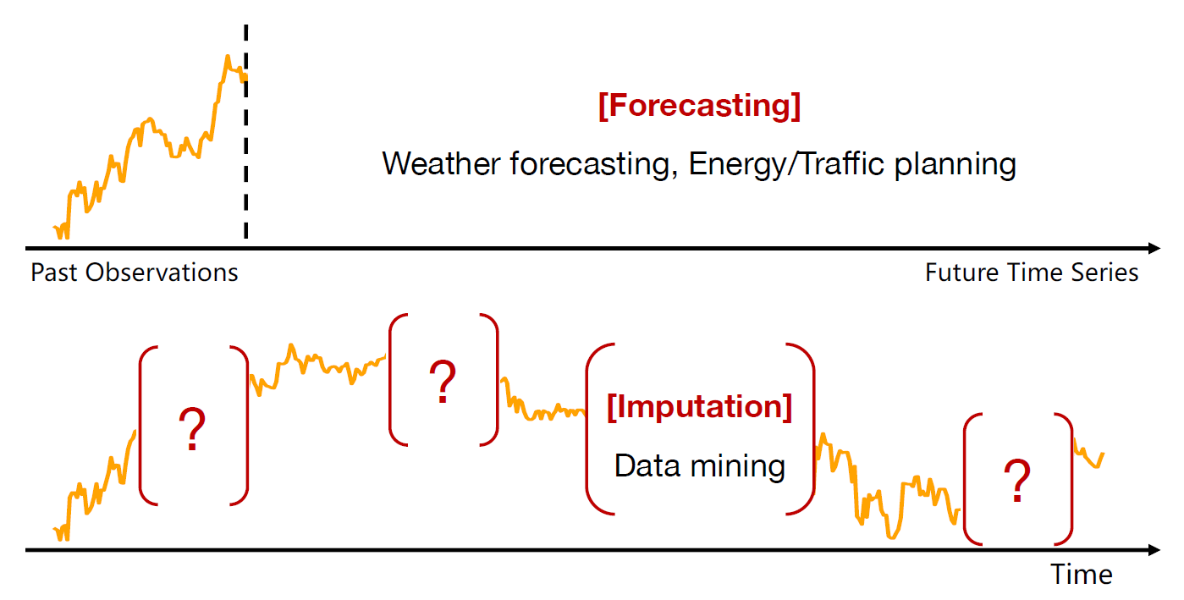
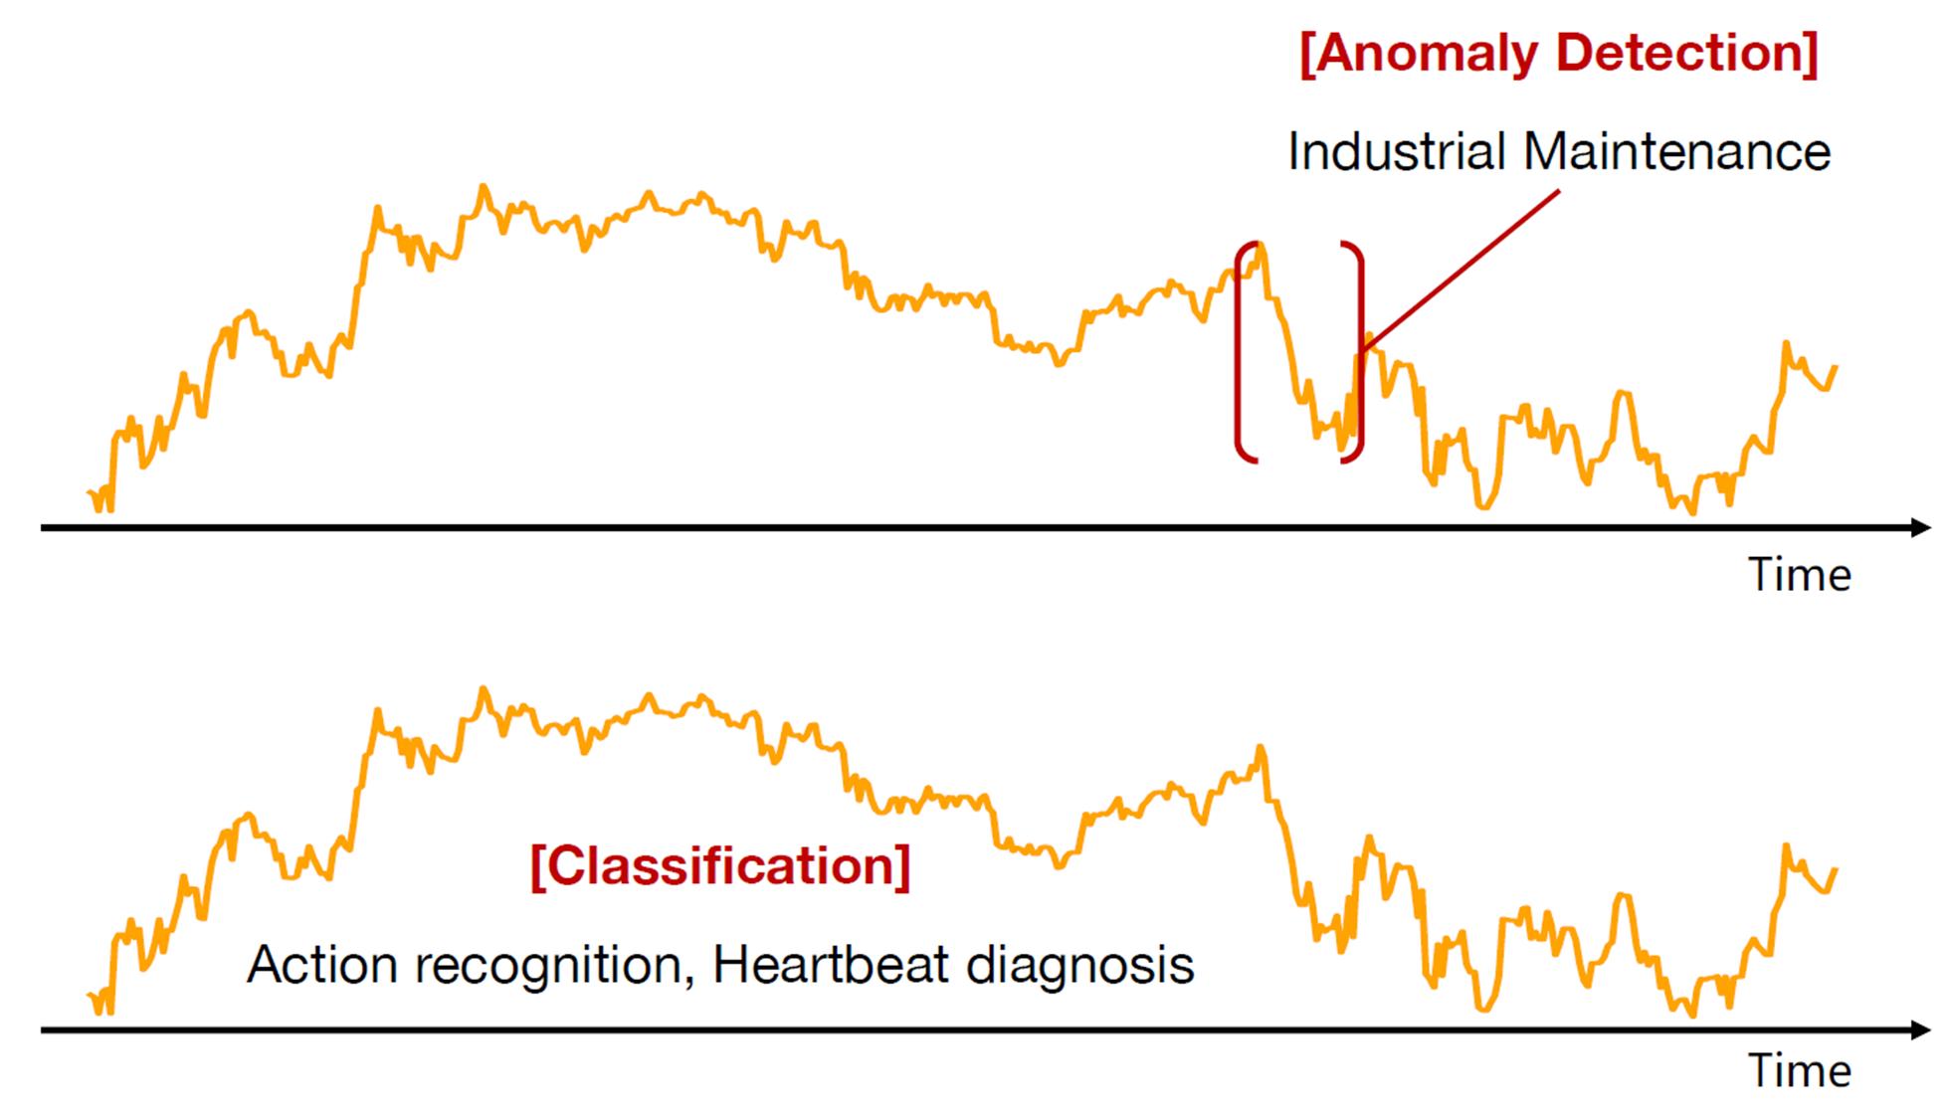
Time-Series Tasks
Forecasting
Long-term Forecasting
Short-term Forecasting
Imputation
Anomaly Detection
Classification
https://wuhaixu2016.github.io/pdf/ICLR2023_TimesNet.pdf

Slide 6
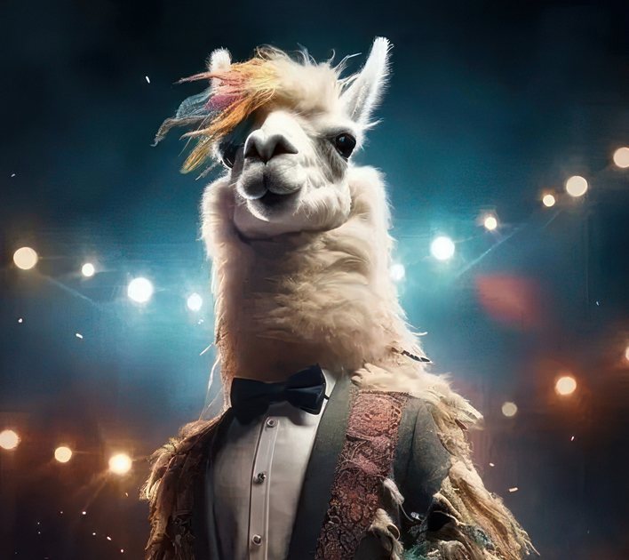


Foundation Models in NLP and CV
Universal backbone with task-specific heads for various tasks
LLaMA 2
DINOv2

Slide 7
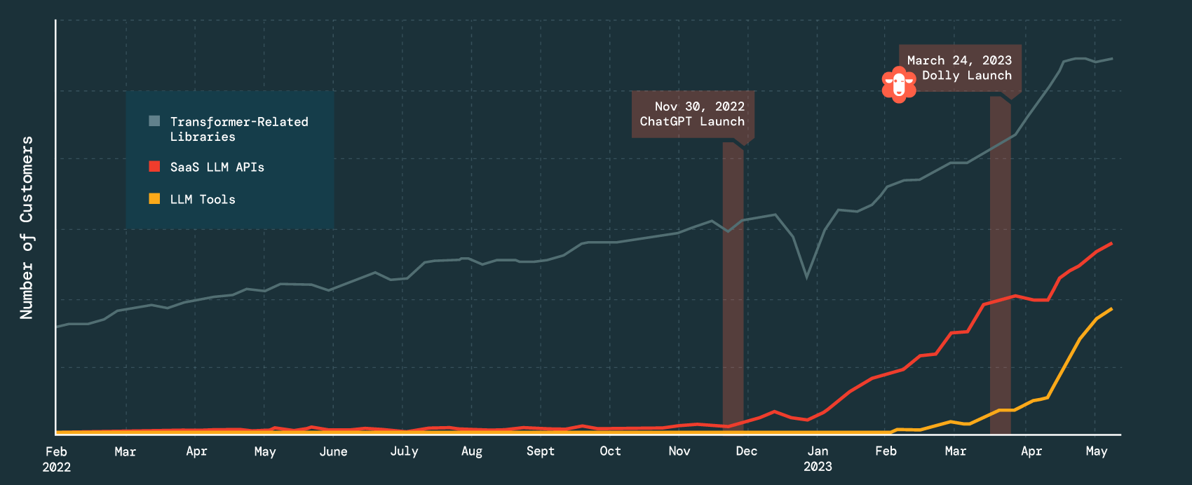
The Usage of Large Language Models (LLMs)
https://twitter.com/matei_zaharia/status/1661044743416184833

Slide 8
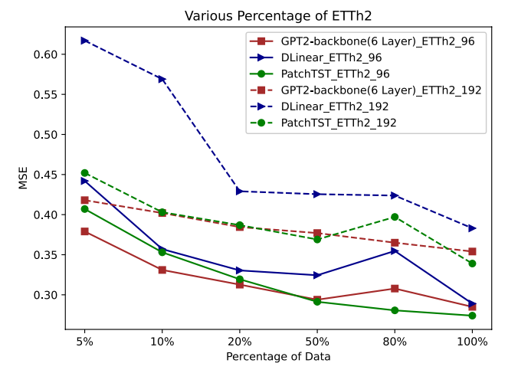
Motivation 1: Few-shot learning

Slide 9
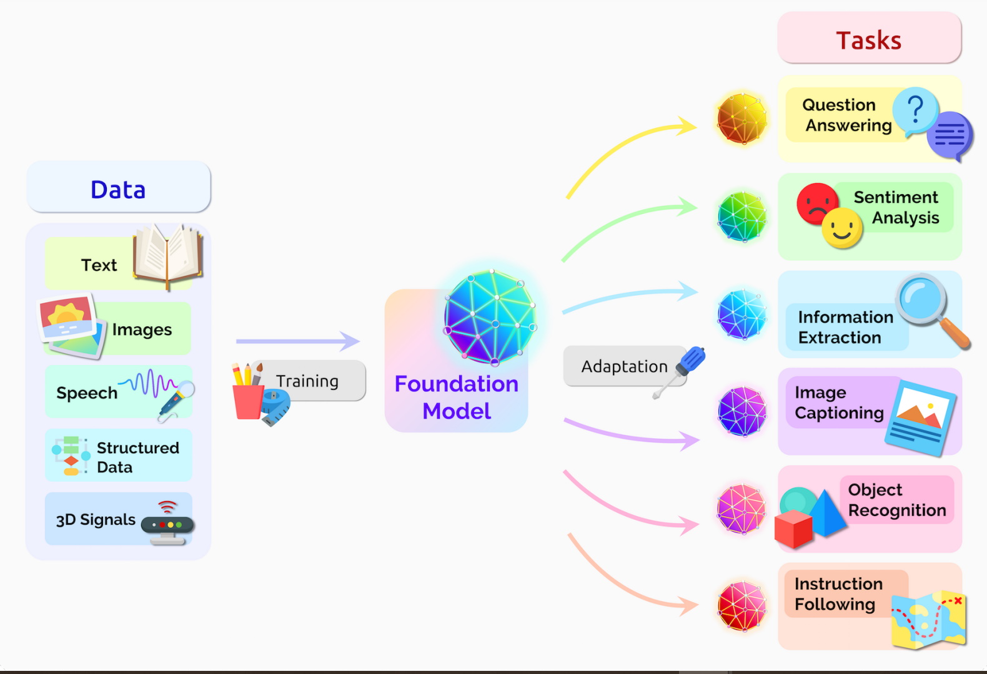

Motivation 2: Multimodal Foundation Models
Time-series
https://blogs.nvidia.com/blog/2023/03/13/what-are-foundation-models/

Slide 10
Related Work

Slide 11
(FPT) Pretrained Transformers As Universal Computation Engines
Kevin Lu, Aditya Grover, Pieter Abbeel, & Igor Mordatch (2022). Frozen Pretrained Transformers as Universal Computation Engines. In AAAI (pp. 7628–7636). AAAI Press.

Slide 12
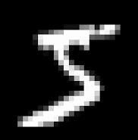
Image Patching
MNIST/CIFAR-10 (image classification)
Original: 32x32 → 10
Now: 4x4 pixel = 1 image patch, so now we have 8x8 = 64 image patches
Input for GPT-2: 64 tokens of dimension 16

Slide 13
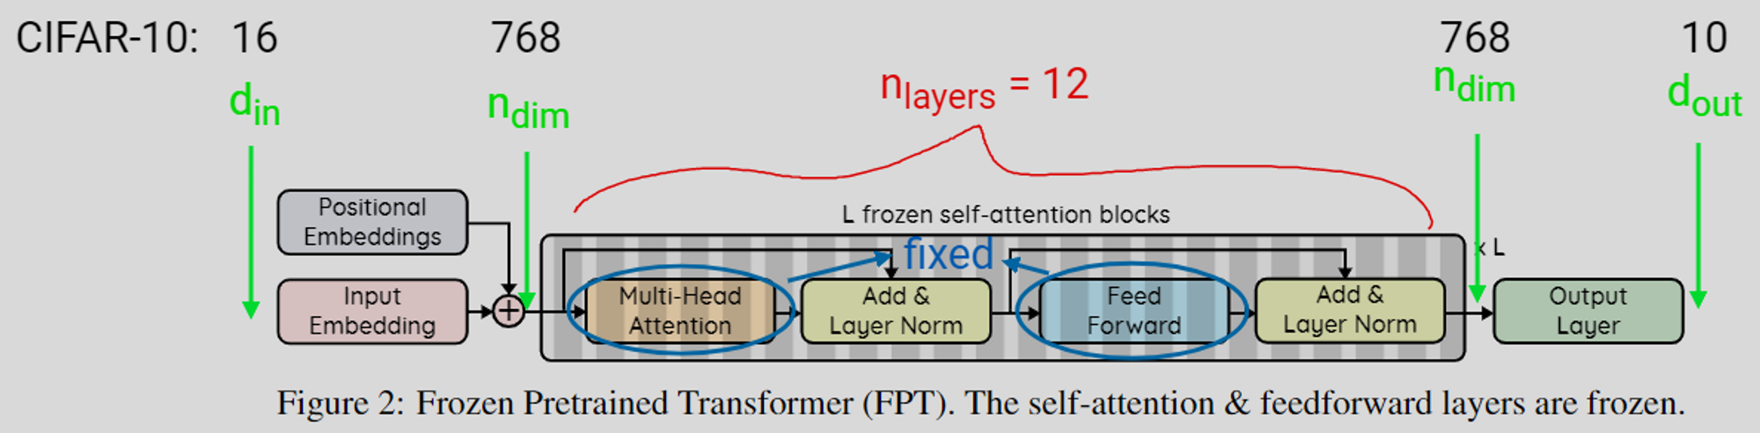
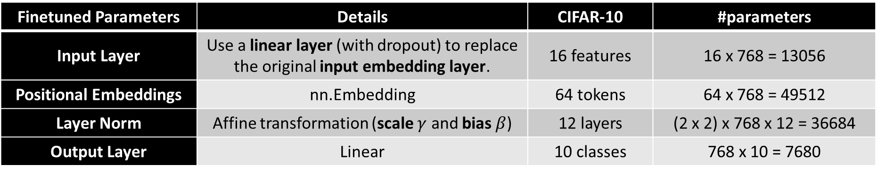
Frozen Pretrained Transformer (FPT)
For the base CIFAR-10 model with 124M parameters, these come out to approximately 0.086% of the network.
Finetuned Parameters | Details | CIFAR-10 | #parameters
Input Layer | Use a linear layer (with dropout) to replace the original input embedding layer. | 16 features | 16 x 768 = 13056
Positional Embeddings | nn.Embedding | 64 tokens | 64 x 768 = 49512
Layer Norm | Affine transformation (scale $γ$ and bias $β$) | 12 layers | (2 x 2) x 768 x 12 = 36684
Output Layer | Linear | 10 classes | 768 x 10 = 7680

Slide 14
(GPT4TS) One Fits All: Power General Time Series Analysis by Pretrained LM
Zhou, Tian, et al. "One Fits All:Power General Time Series Analysis by Pretrained LM." ArXiv, 2023, /abs/2302.11939. Accessed 5 Jul. 2023.

Slide 15
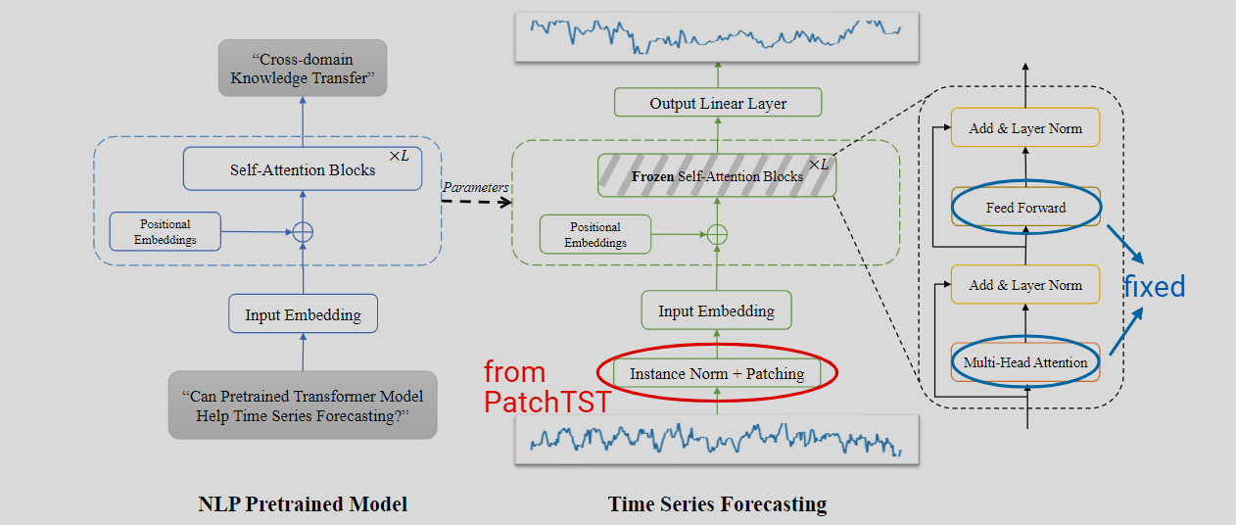
GPT4TS – FPT + PatchTST
Finetuned Parameters
Input Layer
Positional Embeddings
Layer Norm
Output Layer
RevIN
Patching + Channel-Independence

Slide 16
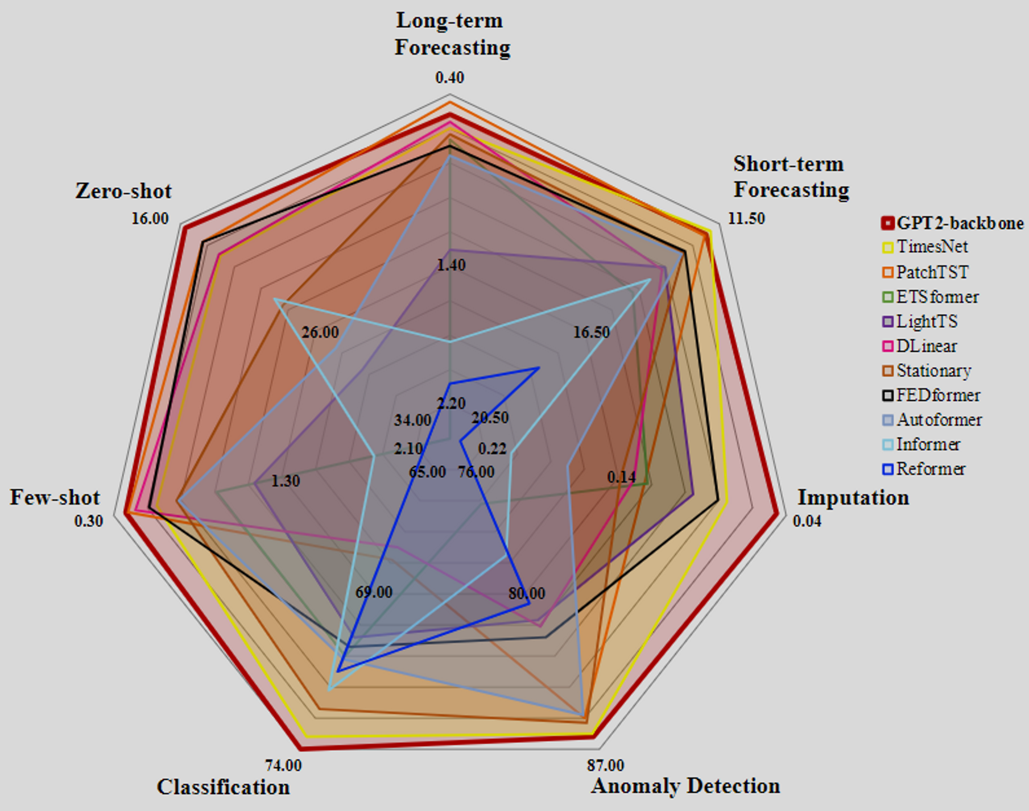
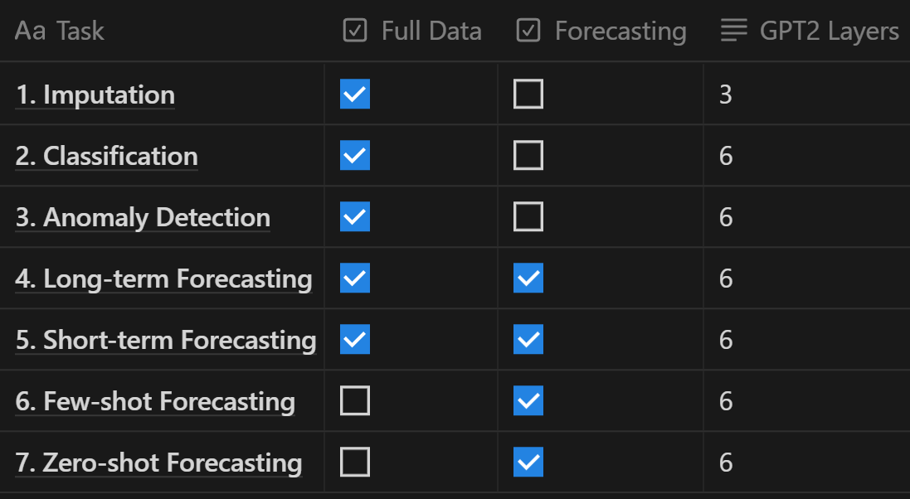
GPT4TS – Results

Slide 17
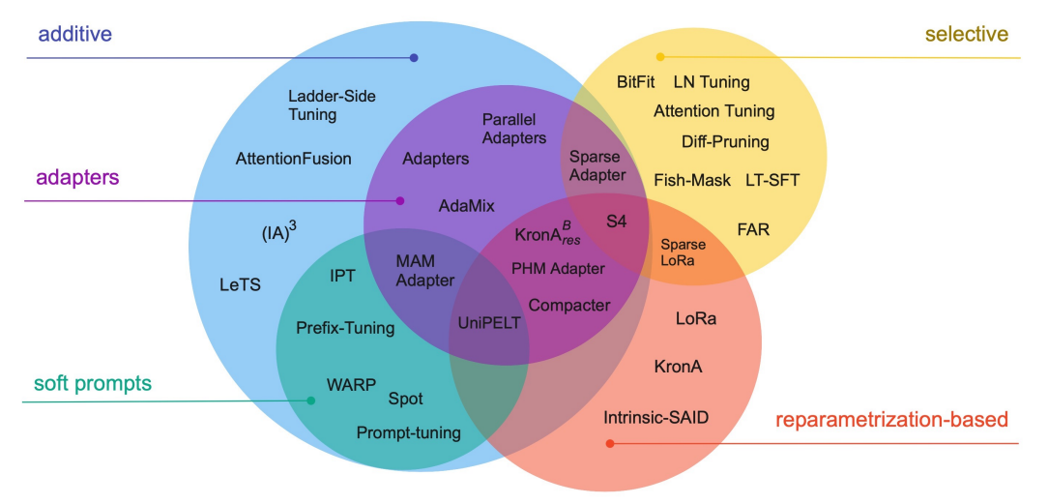
PEFT Methods
Augmenting the existing pre-trained model with extra parameters or layers
Selecting existing parameters or layers
Leveraging low-rank representations to minimize the number of trainable parameters
Lialin, Vladislav, Vijeta Deshpande, and Anna Rumshisky. "Scaling down to scale up: A guide to parameter-efficient fine-tuning." arXiv preprint arXiv:2303.15647 (2023).

Slide 18
Challenges
In applying pretrained LLMs to time-series analysis, supervised fine-tuning is presently unused.
We must first familiarize the LLM with time-series data, then conduct fine-tuning for the downstream tasks, improving robustness and performance.
Solution: Two-stage fine-tuning (supervised + downstream) with time-series patching
Despite the norm of incorporating temporal information in time-series analysis, no attempts have been made to integrate this with time-series patching.
Solution: Temporal Encoding with time-series patching

Slide 19
Solution

Slide 20
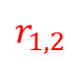
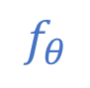
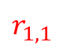
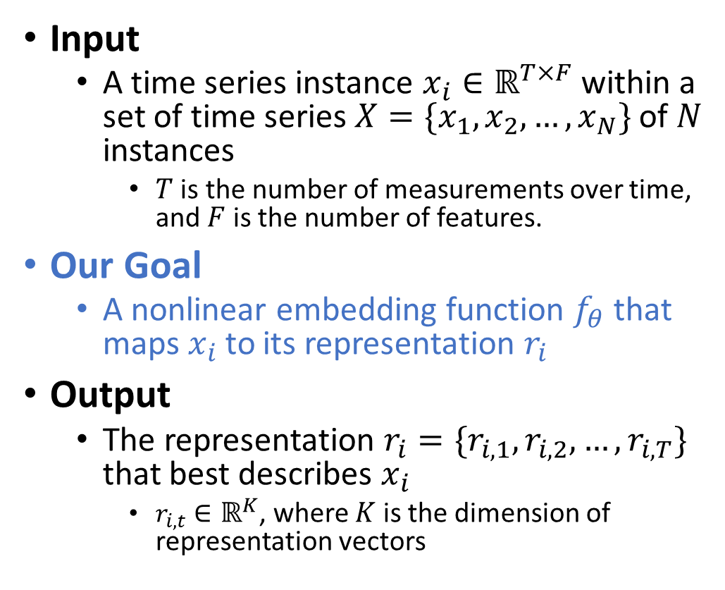
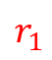
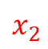
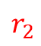
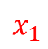
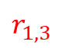
Timestamp-level Representations
features
$$x_{1}$$
Input
A time series instance $x_{i}∈ℝ^{T×F}$ within a set of time series $X=\{x_{1},x_{2}, …,x_{N}\}$ of $N$ instances
$T$ is the number of measurements over time, and $F$ is the number of features.
Our Goal
A nonlinear embedding function $f_{θ}$ that maps $x_{i}$ to its representation $r_{i}$
Output
The representation $r_{i}=\{r_{i,1},r_{i,2}, …,r_{i,T}\}$ that best describes $x_{i}$
$r_{i,t}∈ℝ^{K}$, where $K$ is the dimension of representation vectors
time
$$x_{2}$$
← LLM as feature extractor
$$f_{θ}$$
$$r_{1}$$
$$r_{1,1}$$
$$r_{1,2}$$
$$r_{1,3}$$
$$r_{2}$$

Slide 21
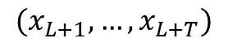
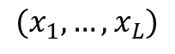
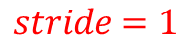
Problem Formulation
$$stride=1$$
$$(x_{1},…,x_{L})$$
$$(x_{L+1},…,x_{L+T})$$
past
future

Slide 22
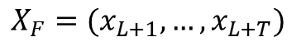
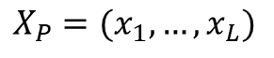
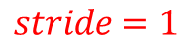
Problem Formulation
$$stride=1$$
past
future
$$X_{P}=(x_{1},…,x_{L})$$
$$X_{F}=(x_{L+1},…,x_{L+T})$$
forecast

Slide 23

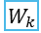
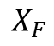
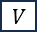
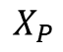


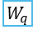
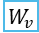
$$X_{F}$$
9
10
24
17
18
32
25
26
40
…
$$×6$$
Add & Layer Norm
…
…
…
RevIN (denorm)
Feed Forward
Output Layer_{SFT}
Flatten + Output Layer_{DFT} + Rearrange
Add & Layer Norm
Pretrained LLM + PEFT
Pretrained LLM + PEFT
Attention
⊕
⊕
$$Q$$
$$K$$
$$V$$
⊕
⊕
Token Encoding
Positional Encoding
Temporal Encoding
Token Encoding
Positional Encoding
Temporal Encoding
$${ W}_{q}$$
LoRA
$${ W}_{k}$$
LoRA
$${ W}_{v}$$
Hidden States
Multi-Head
1
2
16
9
10
24
17
18
32
1
2
16
9
10
24
17
18
32
…
…
…
…
…
…
…
…
Patching +
Channel-Independence
Patching +
Channel-Independence
Frozen
Instance Norm
RevIN (norm)
Fine-tune
Frozen → Fine-tune
$$X_{P}$$
Supervised Fine-Tuning (SFT): Autoregressive
Downstream Fine-Tuning (DFT):
Forecasting

Slide 24
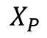
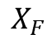
$$X_{F}$$
$$×6$$
9
10
24
17
18
32
25
26
40
…
Add & Layer Norm
…
…
…
RevIN (denorm)
Feed Forward
Output Layer_{SFT}
Flatten + Output Layer_{DFT} + Rearrange
Add & Layer Norm
Pretrained LLM + PEFT
Pretrained LLM + PEFT
Attention
⊕
⊕
$$Q$$
$$K$$
$$V$$
⊕
⊕
Token Encoding
Positional Encoding
Temporal Encoding
Token Encoding
Positional Encoding
Temporal Encoding
$${ W}_{q}$$
LoRA
$${ W}_{k}$$
LoRA
$${ W}_{v}$$
Hidden States
1
2
16
9
10
24
17
18
32
1
2
16
9
10
24
17
18
32
Multi-Head
…
…
…
…
…
…
…
…
Patching +
Channel-Independence
Patching +
Channel-Independence
Frozen
Instance Norm
RevIN (norm)
Fine-tune
Frozen → Fine-tune
$$X_{P}$$

Slide 25
Two-Stage Fine-tuning
9
10
24
17
18
32
25
26
40
…
$$×L$$
Add & Layer Norm
…
…
…
RevIN (denorm)
Feed Forward
Output Layer_{SFT}
Flatten + Output Layer_{DFT} + Rearrange
Add & Layer Norm
Pretrained LLM + PEFT
Pretrained LLM + PEFT
Attention
⊕
⊕
$$Q$$
$$K$$
$$V$$
⊕
⊕
Token Encoding
Positional Encoding
Temporal Encoding
Token Encoding
Positional Encoding
Temporal Encoding
$${ W}_{q}$$
LoRA
$${ W}_{k}$$
LoRA
$${ W}_{v}$$
Hidden States
Multi-Head
1
2
16
9
10
24
17
18
32
1
2
16
9
10
24
17
18
32
…
…
…
…
…
…
…
…
Patching +
Channel-Independence
Patching +
Channel-Independence
Frozen
Fine-tune
Instance Norm
RevIN (norm)
Supervised Fine-Tuning (SFT)
Downstream Fine-Tuning (DFT)

Slide 26
Two-Stage Fine-tuning
9
10
24
17
18
32
25
26
40
…
$$×L$$
Add & Layer Norm
…
…
…
RevIN (denorm)
Feed Forward
Output Layer_{SFT}
Flatten + Output Layer_{DFT} + Rearrange
Add & Layer Norm
Pretrained LLM + PEFT
Pretrained LLM + PEFT
Attention
⊕
⊕
$$Q$$
$$K$$
$$V$$
⊕
⊕
Token Encoding
Positional Encoding
Temporal Encoding
Token Encoding
Positional Encoding
Temporal Encoding
$${ W}_{q}$$
LoRA
$${ W}_{k}$$
LoRA
$${ W}_{v}$$
Hidden States
Multi-Head
1
2
16
9
10
24
17
18
32
1
2
16
9
10
24
17
18
32
…
…
…
…
…
…
…
…
Patching +
Channel-Independence
Patching +
Channel-Independence
Frozen
Fine-tune
Instance Norm
RevIN (norm)
Supervised Fine-Tuning (SFT)
Downstream Fine-Tuning (DFT)

Slide 27
Instance Normalization
9
10
24
17
18
32
25
26
40
…
$$×L$$
Add & Layer Norm
…
…
…
RevIN (denorm)
Feed Forward
Output Layer_{SFT}
Flatten + Output Layer_{DFT} + Rearrange
Add & Layer Norm
Pretrained LLM + PEFT
Pretrained LLM + PEFT
Attention
⊕
⊕
$$Q$$
$$K$$
$$V$$
⊕
⊕
Token Encoding
Positional Encoding
Temporal Encoding
Token Encoding
Positional Encoding
Temporal Encoding
$${ W}_{q}$$
LoRA
$${ W}_{k}$$
LoRA
$${ W}_{v}$$
Hidden States
Multi-Head
1
2
16
9
10
24
17
18
32
1
2
16
9
10
24
17
18
32
…
…
…
…
…
…
…
…
Patching +
Channel-Independence
Patching +
Channel-Independence
Frozen
Fine-tune
Instance Norm
RevIN (norm)
Supervised Fine-Tuning (SFT)
Downstream Fine-Tuning (DFT)

Slide 28
Instance Normalization
Reversible Instance Normalization (RevIN) is designed for scenarios where both the input and output are in a general time-series format.
This is applicable to downstream fine-tuning tasks such as forecasting and imputation.
However, in the context of supervised fine-tuning, this isn't the case because the output is represented as patched time-series data.
9
10
24
17
18
32
25
26
40
…
…
…
…
RevIN (denorm)
…
…
Instance Norm
RevIN (norm)
Supervised Fine-Tuning (SFT)
Downstream Fine-Tuning (DFT)

Slide 29
Patching + Channel-Independence
9
10
24
17
18
32
25
26
40
…
$$×L$$
Add & Layer Norm
…
…
…
RevIN (denorm)
Feed Forward
Output Layer_{SFT}
Flatten + Output Layer_{DFT} + Rearrange
Add & Layer Norm
Pretrained LLM + PEFT
Pretrained LLM + PEFT
Attention
⊕
⊕
$$Q$$
$$K$$
$$V$$
⊕
⊕
Token Encoding
Positional Encoding
Temporal Encoding
Token Encoding
Positional Encoding
Temporal Encoding
$${ W}_{q}$$
LoRA
$${ W}_{k}$$
LoRA
$${ W}_{v}$$
Hidden States
Multi-Head
1
2
16
9
10
24
17
18
32
1
2
16
9
10
24
17
18
32
…
…
…
…
…
…
…
…
Patching +
Channel-Independence
Patching +
Channel-Independence
Frozen
Fine-tune
Instance Norm
RevIN (norm)
Supervised Fine-Tuning (SFT)
Downstream Fine-Tuning (DFT)

Slide 30
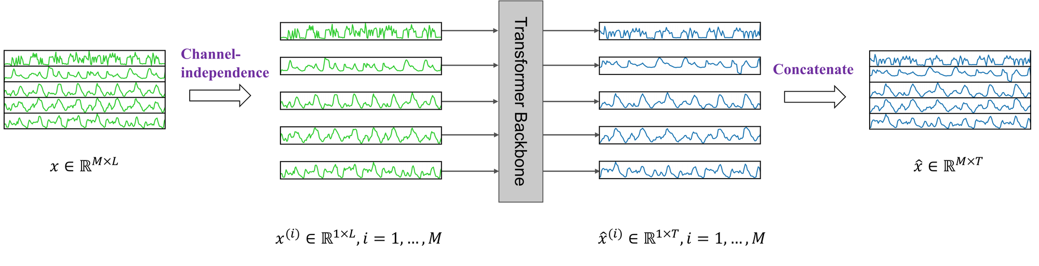
Channel-Independence

Slide 31




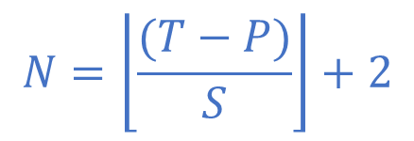



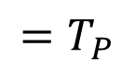
Patching (univariate)
B’
(B, C, T_{P}, P)
(w/ Channel Independence)
…
$$T$$
…
$$C$$
$$N$$
$$=T_{P}$$
$$N$$
…
…
$$P$$
$$S$$
$$P$$
$$N=\left\lfloor \frac{(T−P)}{S}\right\rfloor +2$$

Slide 32
Patching (multivariate)
B’
(B, C, T_{P}, P)
(w/ Channel Independence)
…
$$T$$
…
$$C$$
$$N$$
$$=T_{P}$$
$$N$$
…
…
$$P$$
$$S$$
$$P$$
$$N=\left\lfloor \frac{(T−P)}{S}\right\rfloor +2$$

Slide 33
Encoding (Token, Positional, Temporal)
9
10
24
17
18
32
25
26
40
…
$$×L$$
Add & Layer Norm
…
…
…
RevIN (denorm)
Feed Forward
Output Layer_{SFT}
Flatten + Output Layer_{DFT} + Rearrange
Add & Layer Norm
Pretrained LLM + PEFT
Pretrained LLM + PEFT
Attention
⊕
⊕
$$Q$$
$$K$$
$$V$$
⊕
⊕
Token Encoding
Positional Encoding
Temporal Encoding
Token Encoding
Positional Encoding
Temporal Encoding
$${ W}_{q}$$
LoRA
$${ W}_{k}$$
LoRA
$${ W}_{v}$$
Hidden States
Multi-Head
1
2
16
9
10
24
17
18
32
1
2
16
9
10
24
17
18
32
…
…
…
…
…
…
…
…
Patching +
Channel-Independence
Patching +
Channel-Independence
Frozen
Fine-tune
Instance Norm
RevIN (norm)
Supervised Fine-Tuning (SFT)
Downstream Fine-Tuning (DFT)

Slide 34
Encoding (Token, Positional, Temporal)
(B’, T_{P}, D)
…
Minute
Hour
Weekday
Day
Month
Token Encoding
nn.Linear(P, D) or nn.Conv1d(P, D, kernel_size=3)
Positional Encoding
nn.Embedding(T_{P}, D)
Temporal Encoding
Select the first value in each patch
For each temporal info
nn.Embedding(temporal_size, D)
Sum all embeddings
(B’, T_{P}, P)
1
2
16
9
10
24
17
18
32
…
…
…
…

Slide 35
Pretrained LLM + PEFT
9
10
24
17
18
32
25
26
40
…
$$×L$$
Add & Layer Norm
…
…
…
RevIN (denorm)
Feed Forward
Output Layer_{SFT}
Flatten + Output Layer_{DFT} + Rearrange
Add & Layer Norm
Pretrained LLM + PEFT
Pretrained LLM + PEFT
Attention
⊕
⊕
$$Q$$
$$K$$
$$V$$
⊕
⊕
Token Encoding
Positional Encoding
Temporal Encoding
Token Encoding
Positional Encoding
Temporal Encoding
$${ W}_{q}$$
LoRA
$${ W}_{k}$$
LoRA
$${ W}_{v}$$
Hidden States
Multi-Head
1
2
16
9
10
24
17
18
32
1
2
16
9
10
24
17
18
32
…
…
…
…
…
…
…
…
Patching +
Channel-Independence
Patching +
Channel-Independence
Frozen
Fine-tune
Instance Norm
RevIN (norm)
Supervised Fine-Tuning (SFT)
Downstream Fine-Tuning (DFT)

Slide 36

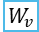
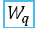



Pretrained LLM + PEFT
Pretrained Large Language Model (LLM)
The affine transformation in Layer Normalization is fine-tuned.
All other parameters remain frozen.
We choose to use gpt2 in this paper.
Parameter-Efficient Fine-Tuning (PEFT)
The latest PEFT methods can be applied to the transformer block.
LoRA
AdaLoRA
IA³
$$×L$$
Add & Layer Norm
Feed Forward
Add & Layer Norm
Attention
Frozen
$$Q$$
$$K$$
$$V$$
Fine-tune
⊕
⊕
$${ W}_{q}$$
LoRA
$${ W}_{k}$$
LoRA
$${ W}_{v}$$
Hidden States
Multi-Head

Slide 37
Output Layer
9
10
24
17
18
32
25
26
40
…
$$×L$$
Add & Layer Norm
…
…
…
RevIN (denorm)
Feed Forward
Output Layer_{SFT}
Flatten + Output Layer_{DFT} + Rearrange
Add & Layer Norm
Pretrained LLM + PEFT
Pretrained LLM + PEFT
Attention
⊕
⊕
$$Q$$
$$K$$
$$V$$
⊕
⊕
Token Encoding
Positional Encoding
Temporal Encoding
Token Encoding
Positional Encoding
Temporal Encoding
$${ W}_{q}$$
LoRA
$${ W}_{k}$$
LoRA
$${ W}_{v}$$
Hidden States
Multi-Head
1
2
16
9
10
24
17
18
32
1
2
16
9
10
24
17
18
32
…
…
…
…
…
…
…
…
Patching +
Channel-Independence
Patching +
Channel-Independence
Frozen
Fine-tune
Instance Norm
RevIN (norm)
Supervised Fine-Tuning (SFT)
Downstream Fine-Tuning (DFT)

Slide 38
Output Layer
(B, T_{out}, C)
(B’, T_{P}, P)
9
10
24
17
18
32
25
26
40
…
…
…
…
RevIN (denorm)
Output Layer_{SFT}
nn.Dropout
nn.Linear(D, P)
Output Layer_{DFT}
nn.Flatten(start_dim=1)
nn.Dropout
nn.Linear(T_{P}*D, T_{out})
Rearrange
(B C) T_out -> B T_out C
(B’, T_{P}, D)
…
…
(B’, T_{P}, D)
Supervised Fine-Tuning (SFT)
Downstream Fine-Tuning (DFT)

Slide 39
Two-Stage Fine-tuning
9
10
24
17
18
32
25
26
40
…
$$×L$$
Add & Layer Norm
…
…
…
RevIN (denorm)
Feed Forward
Output Layer_{SFT}
Flatten + Output Layer_{DFT} + Rearrange
Add & Layer Norm
Pretrained LLM + PEFT
Pretrained LLM + PEFT
Attention
⊕
⊕
$$Q$$
$$K$$
$$V$$
⊕
⊕
Token Encoding
Positional Encoding
Temporal Encoding
Token Encoding
Positional Encoding
Temporal Encoding
$${ W}_{q}$$
LoRA
$${ W}_{k}$$
LoRA
$${ W}_{v}$$
Hidden States
Multi-Head
1
2
16
9
10
24
17
18
32
1
2
16
9
10
24
17
18
32
…
…
…
…
…
…
…
…
Patching +
Channel-Independence
Patching +
Channel-Independence
Frozen
Fine-tune
Instance Norm
RevIN (norm)
Supervised Fine-Tuning (SFT)
Downstream Fine-Tuning (DFT)

Slide 40
Experiments

Slide 41
Experiments
Disclaimer: Not finished
Main results
Long-Term Forecasting
Short-Term Forecasting
Imputation
Few-Shot Learning for Long-Term Forecasting
Ablations
Supervised Fine-Tuning
Temporal Encoding
PEFT
Hyperparameter Analysis
First k layers
Token embedding
patch_len

Slide 42
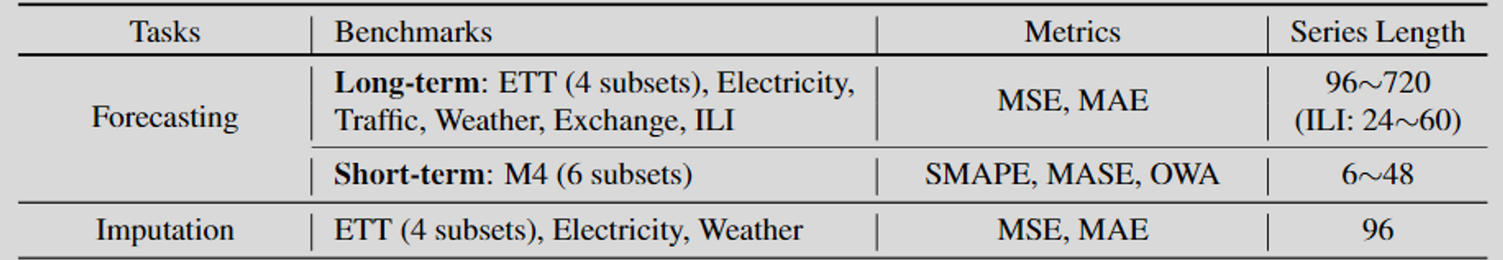
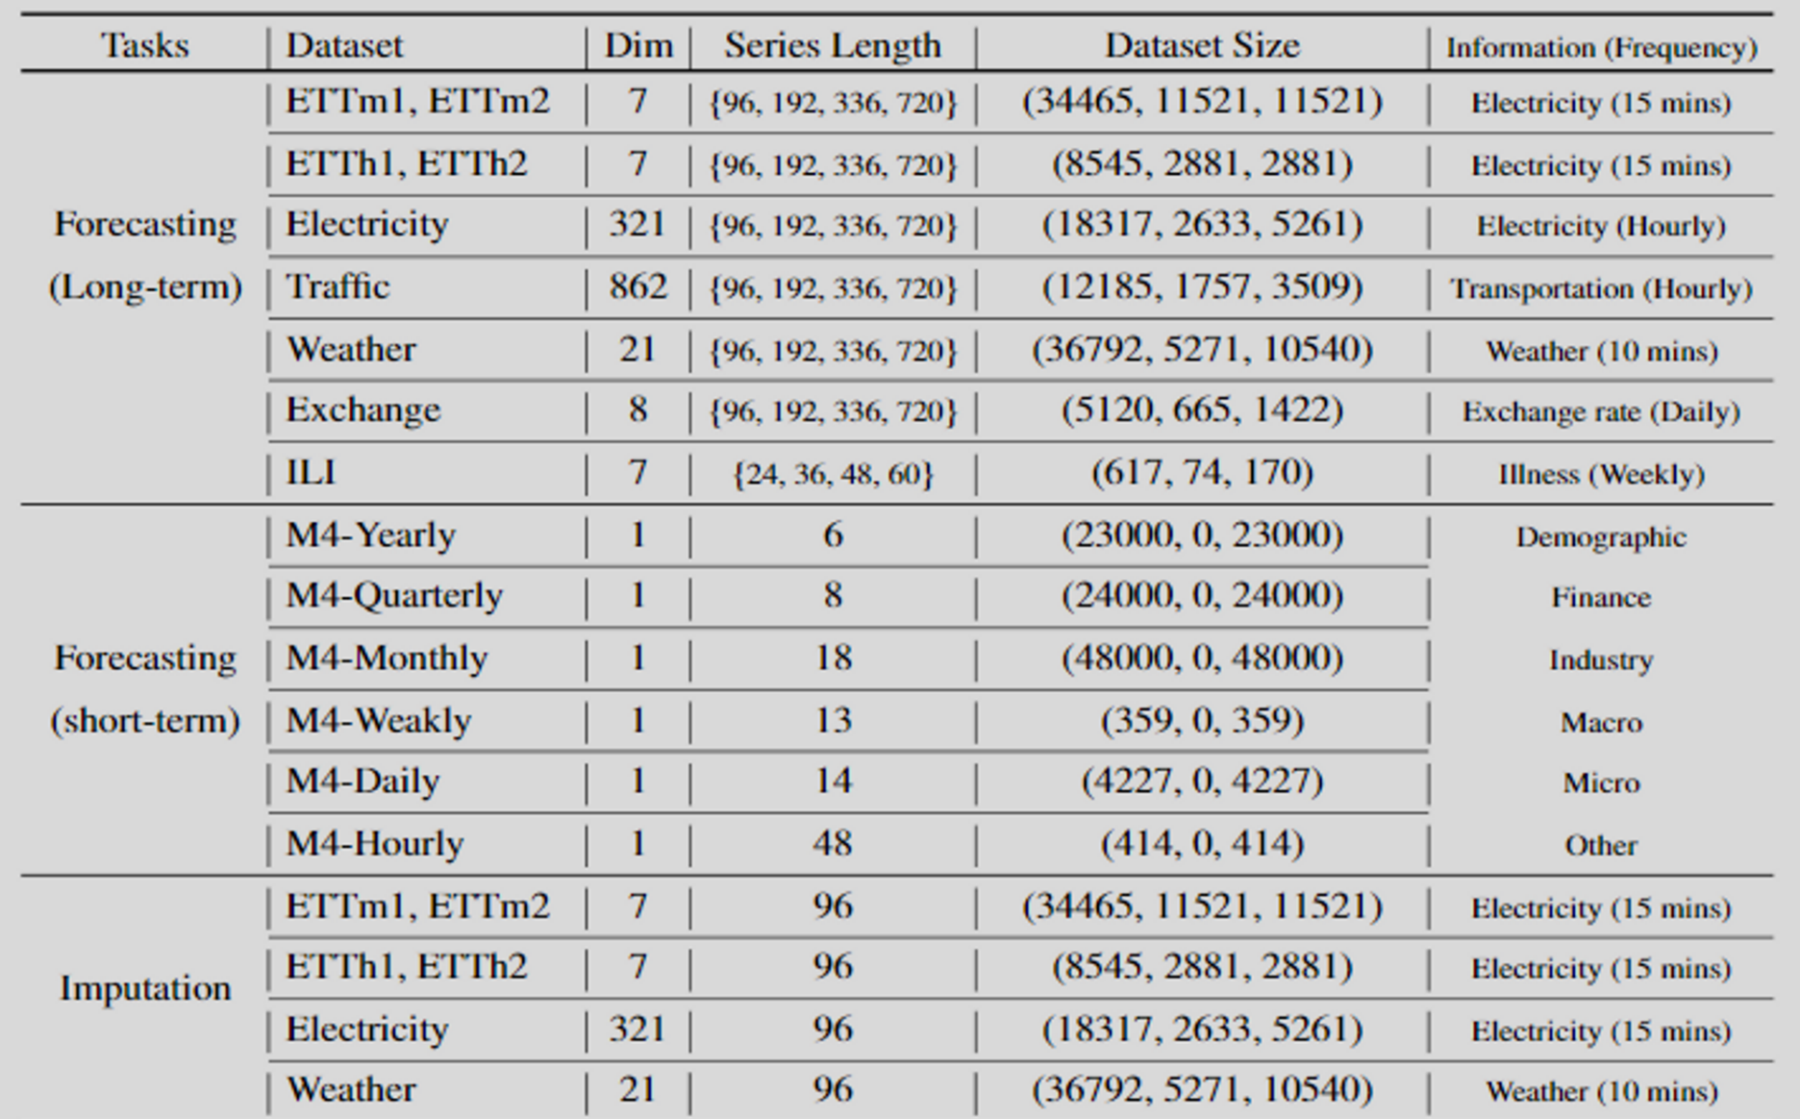
Dataset
Details:
Haixu Wu, Tengge Hu, Yong Liu, Hang Zhou, Jianmin Wang, & Mingsheng Long (2023). TimesNet: Temporal 2D-Variation Modeling for General Time Series Analysis. In ICLR. OpenReview.net.

Slide 43
Baseline Approaches
Use pretrained LLM
GPT4TS
Train from scratch
DLinear (AAAI 2023)
PatchTST (ICLR 2023)
FEDformer (ICML 2022)
Autoformer (NeurIPS 2021)
Informer (AAAI 2021 Best Paper)

Slide 44
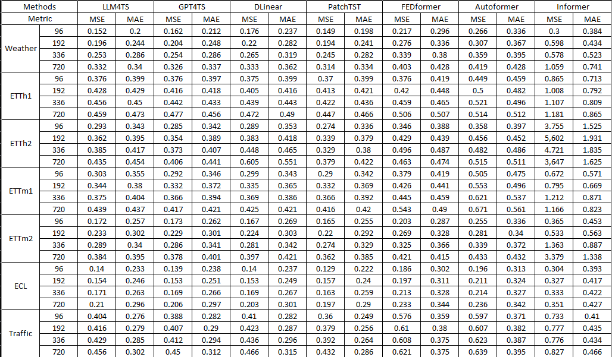
Long-Term Forecasting
pred_len: the number of data points to predict in the future

Slide 45
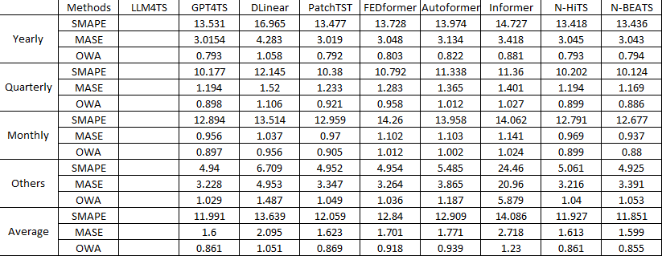
Short-Term Forecasting

Slide 46
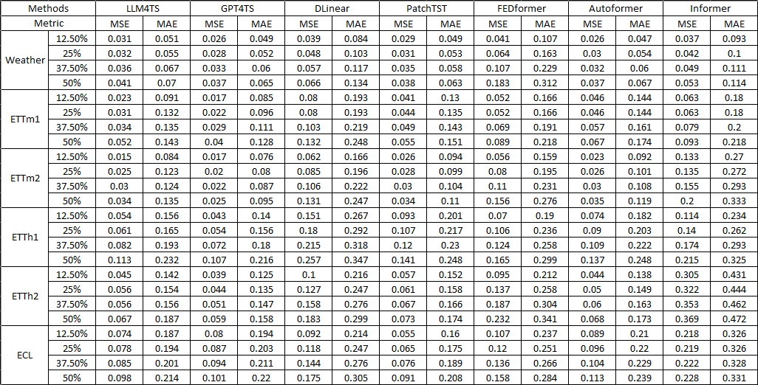
Imputation
mask_ratio: the number of data points to be masked

Slide 47
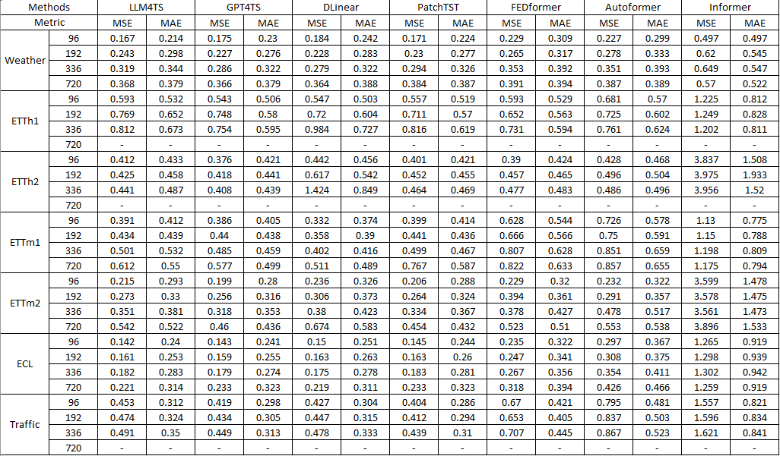
Few-Shot Learning for Long-Term Forecasting
Percentage of data: 5%

Slide 48
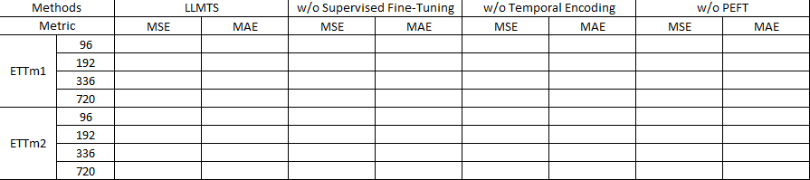
Ablations

Slide 49
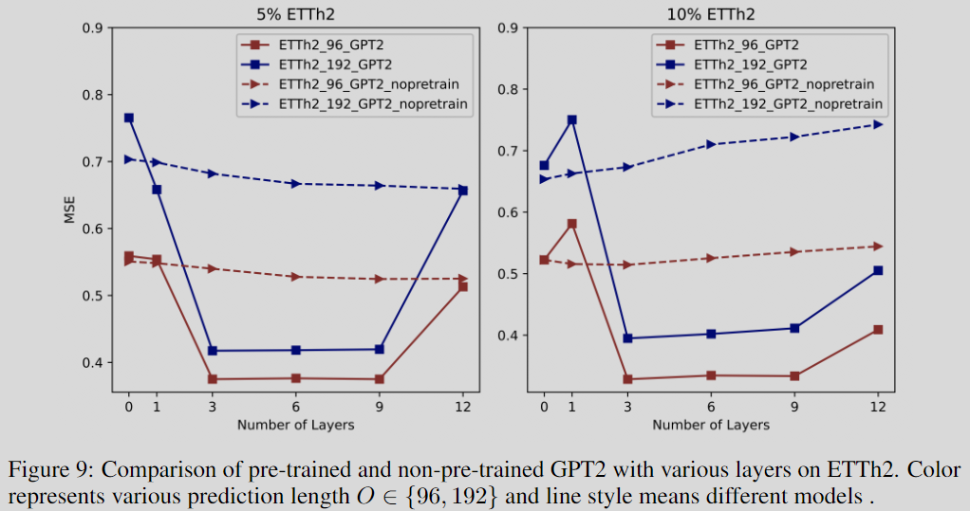

Hyperparameter Analysis

Slide 50
Conclusion

Slide 51
Conclusion
Our goal is to effectively utilize pretrained LLMs to power a comprehensive range of time-series data analysis tasks.
We introduce LLM4TS, a framework that integrates two-stage fine-tuning and temporal embedding with patching.
Additionally, we utilize PEFT techniques to increase flexibility without significantly adding to the training overhead.
We have attained state-of-the-art results across various tasks, including forecasting, imputation, and few-shot learning.

Slide 52
Future Work

Slide 53
Future Work
Other Time-Series Tasks
Other Pretrained LLMs
Meta-transformer

Slide 54
1. Other Time-Series Tasks
Forecasting
Long-term Forecasting
Short-term Forecasting
Imputation
Anomaly Detection
Classification
https://wuhaixu2016.github.io/pdf/ICLR2023_TimesNet.pdf

Slide 55

2. Other Pretrained LLMs
LLaMA / LLaMA-2
7B
Falcon
7B
https://www.cloudbooklet.com/falcon-vs-llama-which-llm-is-better/

Slide 56


LLaMA – 3 Changes
SwiGLU
Pre-normalization [GPT3]
SwiGLU activation function [PaLM]
Rotary Embeddings [GPTNeo]
RMSNorm
RMSNorm
Rotary Embedding
RMSNorm
Touvron, Hugo, et al. "Llama: Open and efficient foundation language models." arXiv preprint arXiv:2302.13971 (2023).

Slide 57


LLaMA-Adapter
In the LLaMA model with 7B parameters, the LLaMA-Adapter fine-tunes 1.2M, or approximately 0.017%, of the network.
V1
Learnable Adaption Prompts
They use real virtual tokens, multiply them by $W_{k}$ and $W_{v}$ for the corresponding $K$ and $V$.
Zero-init Attention
This mechanism uses learnable, zero-initialized parameters passed through tanh
V2
Bias Tuning of Linear Layers
They apply the affine transformation on $W$.
https://github.com/OpenGVLab/LLaMA-Adapter

Slide 58

Falcon-7B
“Truly open” model (Apache 2.0 license)
Need ~15GB of GPU memory
Trained on 1.5T tokens
The key ingredient for the high quality of the Falcon models is their training data
Featuring an architecture optimized for inference, with FlashAttention and multiquery attention.
https://twitter.com/_philschmid/status/1663985494722527235

Slide 59

LLaMA 2
https://huggingface.co/blog/llama2

Slide 60


3. Meta-transformer
Meta-Transformer is the first framework to simultaneously encode data from a dozen of modalities using the same set of parameters.
Zhang, Yiyuan, et al. "Meta-Transformer: A Unified Framework for Multimodal Learning." arXiv preprint arXiv:2307.10802 (2023).

Slide 61
3 Tasks

Slide 62
3 Tasks
LLM4TS
Utilize LLM with time-series analysis using SFT, temporal embedding, and PEFT (AAAI 2024 or ICDE 2024)
Implement LLaMA-2 for general time-series analysis (ICDE 2024 or IJCAI 2024)
Apply the model on tabular data (???)
TimePCL
Employ predictive and contrastive learning for representation learning with time-series data (ICDE 2024)
CausalAI
Achieve scalable causal discovery with missing data on tabular data (KDD 2024 or IJCAI 2024)

Slide 63
TimePCL (Challenges)
Sampling bias
Sampling bias occurs when randomly drawing negative samples from the data distribution may result in negative samples that are actually similar to the reference.
To the best of our knowledge, only one work has attempted to address this problem by using Positive-Unlabeled (PU) learning.
Solution: We address the issue of sampling bias by designing a contrastive task that eliminates the need for negative samples through the incorporation of an additional predictor and stop-gradient operation.
Inappropriate inductive bias
In contrastive learning of time series, most of the work use CV- or NLP-related augmentation methods, which have strong inductive bias like cropping-invariance transformation-invariance.
Solution: We propose a new data augmentation method that involves masking either the temporal or feature dimensions of the time-series data

Slide 64

























TimePCL (Solution)
Temporal mask estimator ($e_{t,θ}$)
Temporal mask estimation loss ($L_{M_{t}}$)
$${\hat{m}}_{t}$$
Temporal mask generator
Temporal view generator ($s_{t}$)
Encoder ($f_{θ}$)
Projector
($g_{θ}$)
Predictor
($q_{θ}$)
Contrastive loss ($L_{C_{t}}$)
$$m_{t}$$
$$v_{t}$$
$$r_{t}$$
$$z_{t}$$
$$p_{t}$$
Unlabeled dataset ($D_{u}$)
stop gradient
$$x$$
stop gradient
Feature mask generator
Feature view generator ($s_{f}$)
Encoder ($f_{θ}$)
Projector
($g_{θ}$)
Predictor
($q_{θ}$)
Contrastive loss ($L_{C_{f}}$)
$$m_{f}$$
$$v_{f}$$
$$r_{f}$$
$$z_{f}$$
$$p_{f}$$
Feature mask estimator ($e_{f,θ}$)
Feature mask estimation loss ($L_{M_{f}}$)
$${\hat{m}}_{f}$$

Slide 65
Thanks for your attention

